Slide 1
Sandwiches, Subs and Wrap Concepts
US, October 2015

Slide 2
The Issues
Consumers wary of processed meats
Freshly prepared foods signal health
Consumers visit fast casuals as soon as income allows

Slide 3
Consumers want healthy foods that are as natural as possible
A series of events related to food product recalls, and questions about animal manufacturing practices has led to consumers questioning all aspects of the food production chain. Visitors to limited service sandwich, sub, and wrap concepts want the most natural, unadulterated foods possible and are willing to pay more for foods they deem to be healthier.
Consumers wary of processed meats
Consumers continue to ask questions regarding the provenance, handling, and processing of their foods.
68% of respondents indicate they prefer natural ingredients
This rises to 71% of women, who tend to be more health- and budget-conscious
Mintel’s trend, Prove It, shows that in light of a series of food recalls, consumers have become more skeptical of factory-farmed foods.
Freshly prepared foods signal health
The rise of fast casual restaurants heightened consumers’ expectations of transparency, both in and outside of the restaurant.
55% of respondents say the most desired attribute of a sandwich, sub, and wrap shop is that it provide foods with fresh ingredients
This focus on health also relates to 31% of consumers who want a variety of portion/size options
27% say they seek foods with health claims, such as hormone-free
Consumers visit fast casuals as soon as income allows
Consumers visit fast food shops more because they seek affordability. However, visits to fast casuals increase with income.
58% of consumers indicate they would be willing to pay more for premium items, such as guacamole or specialty cheeses; these items are more likely to be found at fast casuals
Usage of fast casual shops increases among all groups in the $50K+ bracket.

Slide 4
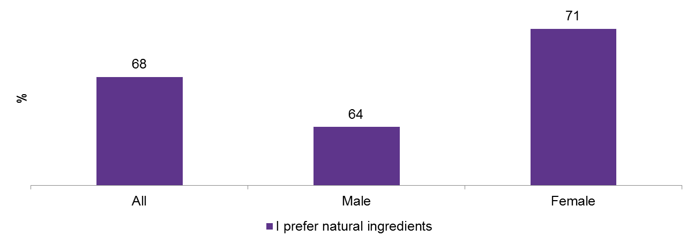
Processed meats not natural enough for consumers
Cold cuts and other meats used in sandwiches are being scrutinized by consumers for a variety of reasons, including being overly processed and including ingredients deemed as unacceptable, such as hormones, artificial colors, and antibiotics. 68% of respondents say they prefer natural ingredients, and this rises to 71% of women, many who are concerned about the quality of foods for their families.
PREFERENCES FOR NATURAL INGREDIENTS AT LSR SANDWICH, SUB AND WRAP SHOPS, BY GENDER, JULY 2015
“How much do you agree or disagree with the following statements about sandwich, sub, and wrap fast food and fast casual restaurants?”
Base: 1,411 internet users aged 18+ who have ordered from a sandwich, sub, or wrap restaurant in the past month
Source: Lightspeed GMI/Mintel

Slide 5
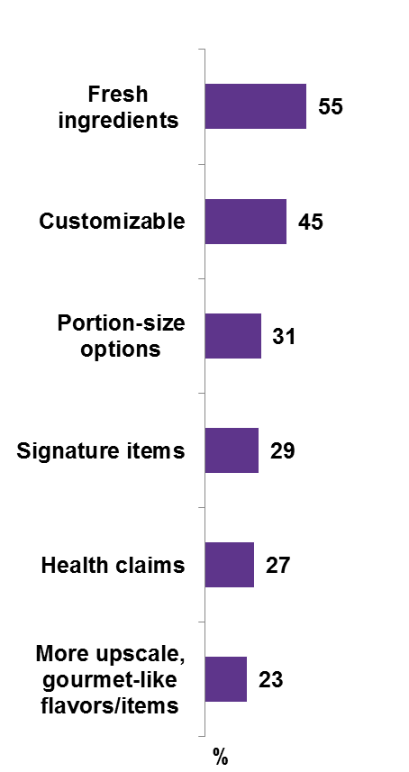
Freshly prepared foods signal health
IMPORTANT ATTRIBUTES OF FOODS AT LSR SANDWICH, SUB AND WRAP SHOPS, JULY 2015
“Which of the following, if any, are most important to you when you are considering which sandwich, sub, and wrap fast food or fast casual restaurant to visit?”
Consumers are dining out regularly and want more control over their health. This means they want foods that are fresh, and they also want to control their intake. A third say they want a variety of portion sizes to choose from, and about a third say they look for foods with health claims such as hormone-free.
Consumers want more variety and choice at sandwich shops: 32% of consumers say they are preparing foods at home more than last year.
Base: 1,411 internet users aged 18+ who have ordered from a sandwich, sub, or wrap restaurant in the past month
Source: Lightspeed GMI/Mintel

Slide 6
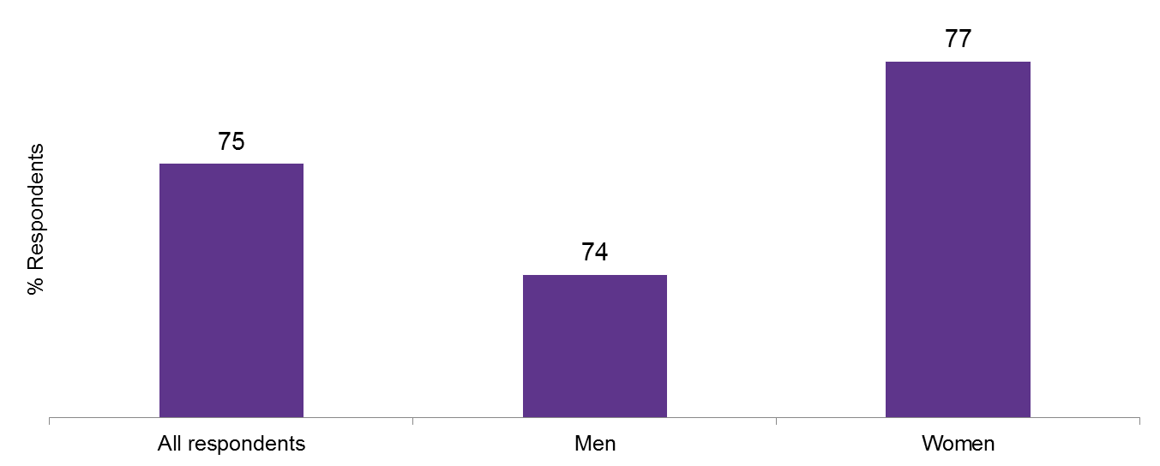
Consumers visit fast casuals as soon as income allows
While consumers visit fast food at a higher rate due to affordability, they being to visit fast casuals more as income increases. There is the perception that fast casual restaurants offer better quality and easily customizable foods. Respondents indicate they are willing to pay more for upscale items: 58% say they are willing to pay more for premium items, such as guacamole and specialty cheeses, and visit fast casuals more as income increases.
WILLINGNESS TO PAY MORE FOR PREMIUM ITEMS AT LSR SANDWICH, SUB AND WRAP SHOPS, BY GENDER, JULY 2015
“How much do you agree or disagree with the following statements about sandwich, sub, and wrap fast food and fast casual restaurants?
Base: 1,411 internet users aged 18+ who have ordered from a sandwich, sub, or wrap restaurant in the past month
Source: Lightspeed GMI/Mintel

Slide 7
THE OPPORTUNITIES
Premium-positioned offerings
Ethnic groups want authentically ethnic items
Older demographics are underserved

Slide 8
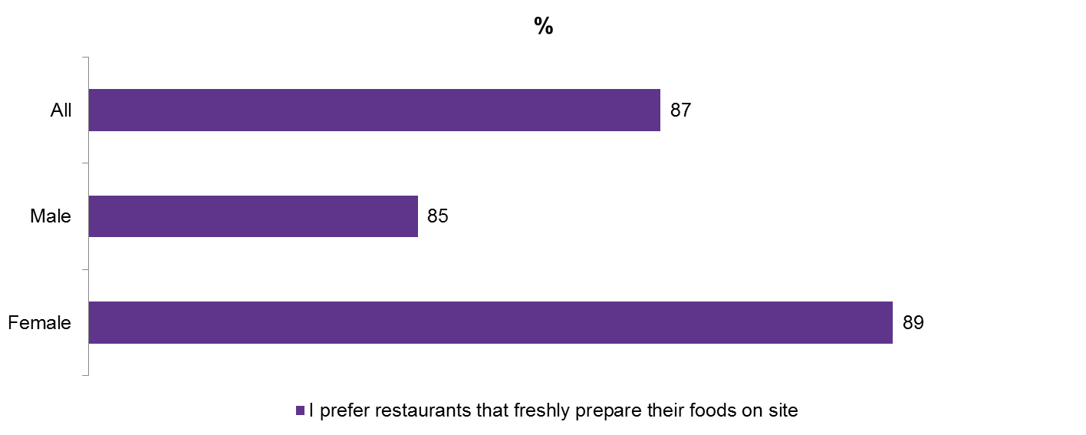
Consumers willing to pay for premium-positioned offerings
87% of respondents indicate they prefer sandwich concepts that freshly prepare their foods on site, a practice closely tied to fast casual brands. Fast casual brands are also feature more purity claims, such as non-GMOs, hormone-free, antibiotic-free, and organic. Consumers indicate they are willing to pay more for premium-positioned foods, so offering menu items that cater to both value-minded consumers and more experience-based consumers is a good way to capture a mass audience.
ATTITUDES TOWARD FRESHLY PREPARED FOODS AT LSR SANDWICH, SUB AND WRAP SHOPS, BY GENDER, JULY 2015
“How much do you agree or disagree with the following statements about sandwich, sub, and wrap fast food and fast casual restaurants?
Base: 1,411 internet users aged 18+ who have ordered from a sandwich, sub, or wrap restaurant in the past month
Source: Lightspeed GMI/Mintel

Slide 9
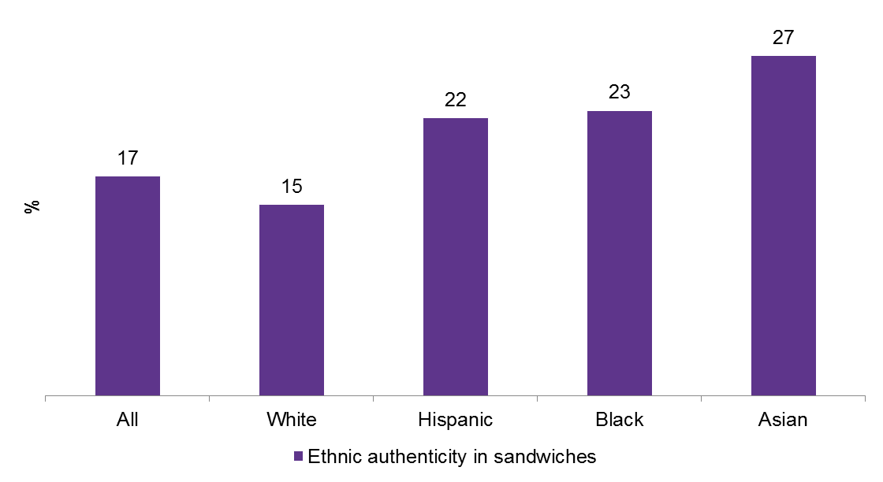
Ethnic consumers seek authentic global foods
There has been a rise in ethnically oriented sandwich concepts providing global versions, such as Mexican tortas and molletes; Vietnamese bahn mi; and Peruvian sanguches. Both fast food and fast casual concepts can incorporate the different types of breads, meats, and sauces used in global presentations. Further, they can be used to target Asians, Blacks, and Hispanics, who show a significant interest in international flavors, when compared to the general population.
IMPORTANCE OF ETHNIC AUTHENTICITY AT LSR SANDWICH, SUB AND WRAP SHOPS, BY RACE, JULY 2015
“Which of the following, if any, are most important to you when you are considering which sandwich, sub, and wrap fast food or fast casual restaurant to visit?
Base: 1,411 internet users aged 18+ who have ordered from a sandwich, sub, or wrap restaurant in the past month
Source: Lightspeed GMI/Mintel

Slide 10
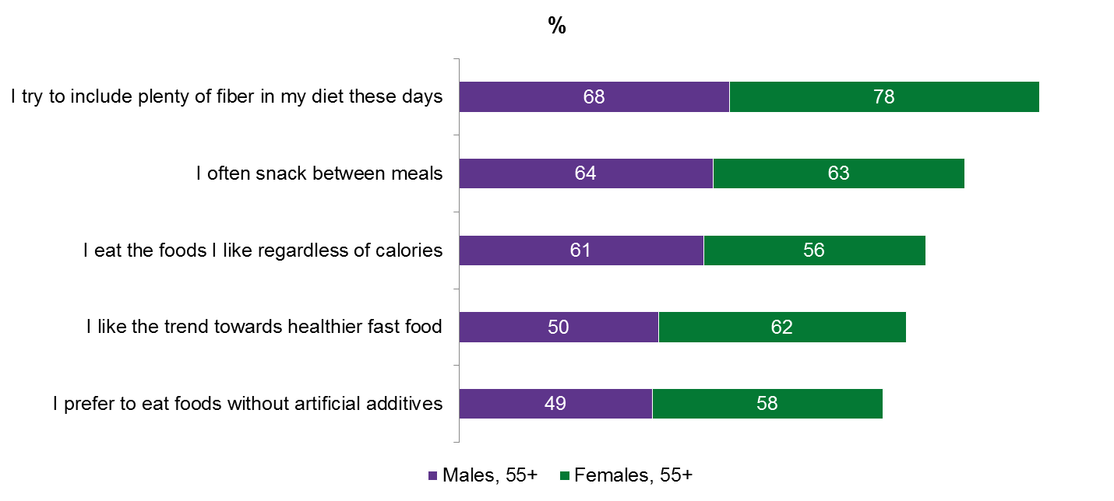
Older consumers need healthier fare at affordable prices
Older respondents are concerned with their health and weight, and typical sandwiches, subs, and wraps have too much fat, sodium and calories to be appealing. But, snacking is one way to appeal to them: about 63% of those aged 55+ snack between meals. They also are focused on healthier properties, such as fiber. Offering foods with functional properties, in a variety of portion sizes, is a way to appeal to this older group that generally has a higher level of disposable income, yet still seeks affordable options.
GENERAL ATTITUDES AND OPINIONS ABOUT FOOD, APRIL 2014-JUNE 2015
“Please tell us the extent to which you agree or disagree with each statement by marking one box opposite each statement.”
Base: 5,391 men aged 55+
Base: 6,872 women aged 55+
Source: Experian Marketing Services, Spring 2015 Simmons NHCS Adult Study 12-month. Copyright: [2015] Experian Information Solutions, Inc. All Rights Reserved/Mintel

Slide 11
What it Means
Foodservice operators have focused much of their attention on Millennials, though other demographic groups, such as women, ethnic groups, and older consumers also offer a wide consumer base. These groups have different needs, so diversifying menu items, by offering a wider range of healthier foods, bolder flavors, portion sizes, and supplying items at different price points, is a good way to capture a variety of consumers.
Fast food operators must improve the quality of their offerings in order to retain market share in a business environment where consumers expect quality ingredients and business transparency. For example, consumers want pure, natural meats, so informing consumers about how they will reach these goals is important in building trust. Even if quality goals cannot be reached immediately, letting consumers know of long-term plans will allow them to know the brand is on pulse and willing to make changes they see as positive.
Fast food places need to do more to appeal to families, as parents use fast food places more than fast casual. This means providing foods that are healthier, in smaller portions and that have natural positionings. Parents are more sensitive about the diets of their younger children, so positioning foods as being good for the kids is key to gaining their trust, and increasing visitation.

Slide 12

Julia Gallo-Torres
Senior Foodservice Analyst
Phone +1 (312) 932 0400
Email info@mintel.com

